Slide 1
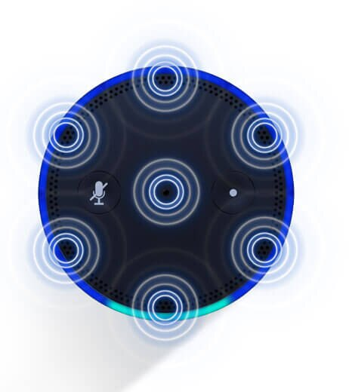

Voice Localization using Nearby Wall Reflections
Yu-Lin Wei,
Sheng Shen, Daguan Chen, Zhijian Yang,
Romit Roy Choudhury
Notes:
Hello everyone. My name is Yu-Lin Wei from University of Illinois, Urbana Champaign. Today, I’m going to present our work Voice Localization using Nearby Wall Reflections.

Slide 2

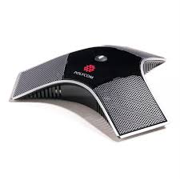
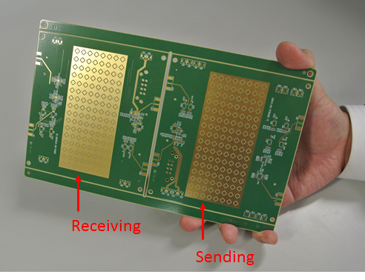
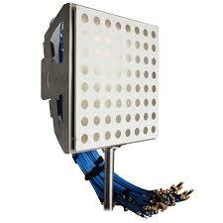
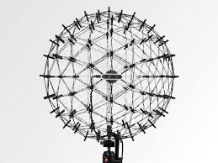
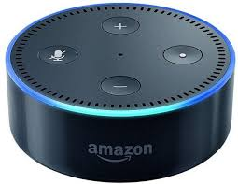


AoA (Angle of Arrival) = Angle $θ$ in which a signal arrives
$$θ$$
Notes:
Our work focuses on solving the angle of arrival (AoA) problem.
The problem formulation is simple: if we have a microphone array,<br> how can we estimate the angle in which a signal arrives.<br>
This technique is widely adapted in various products like smart speakers, conference microphone, and directional antenna,

Slide 3
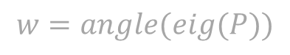
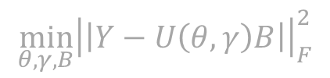
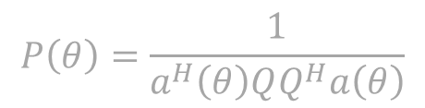
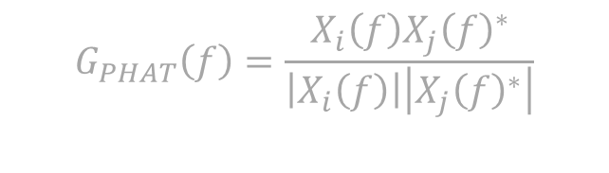
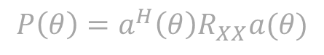
Many variants of the problem … many AoA Algorithms
Delay-Sum
GCC-PHAT
$$G_{PHAT}\left(f\right)=\frac{X_{i}\left(f\right)X_{j}{\left(f\right)}^{∗}}{\left|X_{i}\left(f\right)\right|\left|X_{j}{\left(f\right)}^{∗}\right|}$$
$$P\left(θ\right)=a^{H}\left(θ\right)R_{XX}a(θ)$$
MUSIC
ESPRIT
JADE
$$P\left(θ\right)=\frac{1}{a^{H}\left(θ\right)QQ^{H}a\left(θ\right)}$$
$$\min_{θ,γ,B}{{\left|\left|Y−U\left(θ,γ\right)B\right|\right|}_{F}^{2}}$$
$$w=angle(eig(P))$$
Notes:
AoA is an important and well-researched problem. So there are many variants…
And also many excellent works solving this problem like GCC-PHAT, MUSIC, etc.

Slide 4
Many variants of the problem … many AoA Algorithms
Delay-Sum
GCC-PHAT
$$G_{PHAT}\left(f\right)=\frac{X_{i}\left(f\right)X_{j}{\left(f\right)}^{∗}}{\left|X_{i}\left(f\right)\right|\left|X_{j}{\left(f\right)}^{∗}\right|}$$
$$P\left(θ\right)=a^{H}\left(θ\right)R_{XX}a(θ)$$
MUSIC
ESPRIT
JADE
$$P\left(θ\right)=\frac{1}{a^{H}\left(θ\right)QQ^{H}a\left(θ\right)}$$
$$\min_{θ,γ,B}{{\left|\left|Y−U\left(θ,γ\right)B\right|\right|}_{F}^{2}}$$
$$w=angle(eig(P))$$
But still an open problem for MULTI-ECHO environment
Notes:
However, AoA is still an open problem under some conditions. In this work, we are solving this problem considering many echoes in the environment

Slide 5
This paper
1. A new AoA algorithm
2. Application: voice localization
Notes:
In this talk, I’ll first present a new AoA algorithm, and later show how it could be used in an indoor localization scenario.

Slide 6
What makes the problem challenging?
Notes:
Let’s first see what makes AoA challenging? We have a microphone array as the receiver

Slide 7

What makes the problem challenging?
1
N
# of sources
Notes:
And we might have different number of sources. Either single source or N>1 sources

Slide 8
What makes the problem challenging?
K
# of echoes modeled
1
N
# of sources
1
Notes:
And each of them might produce one, or K more than 1 echoes

Slide 9
What makes the problem challenging?
French
K
# of echoes modeled
Latin
1
N
# of sources
German
1
Source signals are unknown!
Notes:
Moreover, the source signals are unknown

Slide 10





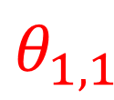
What makes the problem challenging?
French
$$θ_{1,2}$$
K
# of echoes modeled
Latin
$$θ_{1,1}$$
Holy Grail
$$θ_{3,1}$$
1
(Very challenging)
N
$$θ_{3,2}$$
# of sources
$$θ_{2,2}$$
German
$$θ_{2,1}$$
1
Goal: separate all N x K signal AoAs.
Notes:
And the goal is to separate the received signals, and estimate all N times K signal AoAs

Slide 11
Existing solutions have made significant progress …
French
$$θ_{1,2}$$
K
# of echoes modeled
Latin
$$θ_{1,1}$$
Holy Grail
$$θ_{3,1}$$
1
(Very challenging)
N
$$θ_{3,2}$$
# of sources
$$θ_{2,2}$$
German
$$θ_{2,1}$$
1

Slide 12
Existing solutions have made significant progress …
French
K
# of echoes modeled
Latin
$$θ_{1,1}$$
Holy Grail
$$θ_{3,1}$$
1
(Very challenging)
N
# of sources
MUSIC
German
$$θ_{2,1}$$
(Source uncorrelated)
1
Assumes signals are un-correlated
Notes:
For example, MUSIC algorithm can estimate the AoA of many source signals. <br> But it assumes all the signals are uncorrelated

Slide 13
Existing solutions have made significant progress …
French
K
# of echoes modeled
Latin
$$θ_{1,1}$$
Holy Grail
1
(Very challenging)
N
# of sources
GCC-PHAT
MUSIC
German
(Line-of-Sight AoA)
(Source uncorrelated)
1
Only estimate the Line-of-Sight AoA
Notes:
GCC algorithm can estimate the direct path AoA quite well even if there are many echoes. <br>
But it can only estimate the direct path

Slide 14
This paper: Voice Localizaion (VoLoc)
French
$$θ_{1,2}$$
K
# of echoes modeled
Latin
$$θ_{1,1}$$
VoLoc
Holy Grail
1
(Very challenging)
N
# of sources
GCC-PHAT
MUSIC
German
(Line-of-Sight AoA)
(Source uncorrelated)
1
Estimating multiple, fully correlated echoes
Notes:
Our work, VoLoc, target to estimate all the AoAs of the echoes, in other words, we want to model all mutiple fully correlated echoes.
Fully correlated because these echoes are from a same source.

Slide 15
Opportunities on AoA
Notes:
To show how we separate the direct path from the reflected signal, let’s first zoom in to how conventional AoA algorithms work, and we can find opportunities inside.

Slide 16





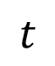
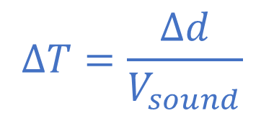
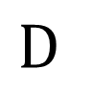
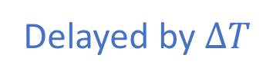
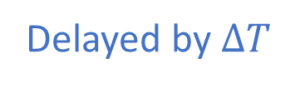

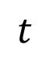
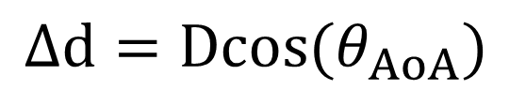
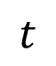


Conventional AoA algorithm
$$Δd=Dcos(θ_{AoA})$$
$$ΔT=\frac{Δd}{V_{sound}}$$
$$Δd$$
$$θ_{AoA}$$
$$D$$
$$t$$
$$t$$
$$t$$
Delayed by $ΔT$
Delayed by $ΔT$
ΔT and AoA: 1-to-1 mapping
A simple correlation can find $ΔT$, hence AoA
Notes:
How can we estimate the AoA using the microphone array?
Here we give an example of three microphone, and they are separated with same distance D
When the signal comes from an AoA theta, the left microphone first received the signal, and then the middle microphone after delta T seconds.
This is because the signal needs to travel a additional distance delta d, to arrive at the middle microphone.
And similarly, it arrives at the right microphone after another delta t seconds.
From geometry, we can see that both delta d and delta t is decided by the AoA theta, or we can say, the delta t and AoA is a one to one mapping
So we can use a simple correlation to find the signal delays between microphone, and infer the AoA

Slide 17
Conventional AoA algorithm
With (infinite number of) echoes … ΔT’s are getting mixed
Impossible to decouple each ΔT from the mixture
Notes:
But what if there are many paths from different direction? In this case each path will have different AoA, and hence different delta T.
These signal delay are getting mixed, and it’s nearly impossible to decouple each delta t if we don’t know the source signal

Slide 18
Key opportunity – Human speech has many pauses
“Alexa, what time is it?”
Time (second)
Notes:
So we’re introducing out key opportunity – human speech has many pauses, so we can leverage the time of each after each pause.
As shown in the red circle here. Right after the pause, the signal is not polluted by previous echoes because previous window is silence.

Slide 19
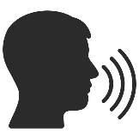

Pause opportunity
ABCDEFG …
Voice Samples
Notes:
Let’s zoom in to the voice signal, we denote the command as ABCDEFG and so on in time domain.
And there’s no voice before symbol A.

Slide 20
Pause opportunity
Path #3 (2nd Echo)
a b c …
a b c …
a b c …
Path #2 (1st Echo)
A B C …
A B C …
Path #1 (Direct Path)
A B C …
a b c …
a b c …
a b c …
Notes:
Let’s say there are 3 paths from the user to the microphone.
Microphone will receive the capital ABC from the direct path, and lower-case abc from the second path.
After a while, the third path comes as underscore abc

Slide 21
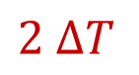
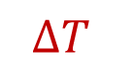
A B C D E F G H I J K L M N ⋮
$$ΔT$$
$$2 ΔT$$
A B C D E F G H I J K L ⋮
A B C D E F G H I J ⋮
Time
Notes:
If we plot the received signal on the timeline, we can see that, the signal first arrives at the left microphone first, and then the middle one after delta T seconds.
And then the right one.

Slide 22
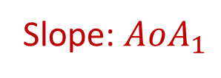
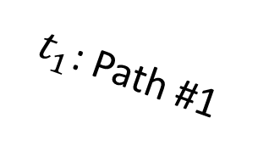
$t_{1}^{ }$: Path #1
A B C D E F G H I J K L M N ⋮
A B C D E F G H I J K L ⋮
A B C D E F G H I J ⋮
Slope: ${AoA}_{1}$
Time
Notes:
This slope is decided by the direct path AoA. For example, here we can see the signal comes from the left-hand side because it arrives at the left microphone earlier.

Slide 23
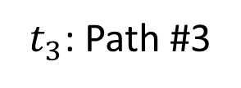
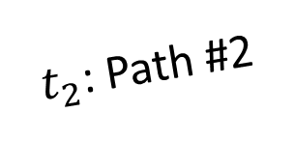
$t_{1}^{ }$: Path #1
A B C D E F G H I J K L M N ⋮
A B C D E F G H I J K L ⋮
A B C D E F G H I J ⋮
a b c d e f
g ⋮
a b c d e f
⋮
a b c d e ⋮
$t_{2}^{ }$: Path #2
a b ⋮
a b ⋮
a b ⋮
$t_{3}^{ }$: Path #3
Time
Notes:
The second path will arrive later. It’s reflected by the wall, so the path is longer. Denoted as the blue lower case abc here Also we’ll see a slope of the blue signal here, and this slope is decided by the second path AoA. In this figure, we can see that the second path comes from right hand side. And similarly we can see how the third path joins.

Slide 24
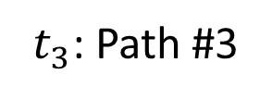
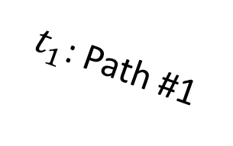
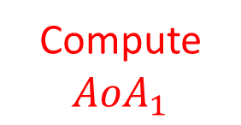
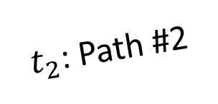
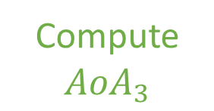
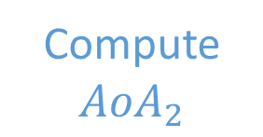
$t_{1}^{ }$: Path #1
A B C D E F G H I J K L M N ⋮
A B C D E F G H I J K L ⋮
Compute $${AoA}_{1}$$
A B C D E F G H I J ⋮
a b c d e f
g ⋮
a b c d e f
⋮
a b c d e ⋮
Compute $${AoA}_{2}$$
$t_{2}^{ }$: Path #2
a b ⋮
a b ⋮
a b ⋮
$t_{3}^{ }$: Path #3
Compute $${AoA}_{3}$$
Time
Notes:
Here we can see that, before the first blue symbol, or the second path signal joins, the received signal is only affected by the direct path.
So we can use this segment to compute the direct path AoA. And before the green third path joins, this segment is only composed of direct path and second path. So we can use this segment to compute the second AoA, and so on. So after pauses in the speech, we see that the direct path, second path are joining one by one.
This gives us the chance to solve the AoA of the these paths one by one.

Slide 25
Iterative Align and Cancel (IAC) algorithm
Notes:
Here, I’m going to introduce our core algorithm: iterative align and cancel. This algorithm takes the received signal as the input and output the AoA of each path.

Slide 26


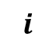
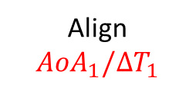

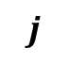

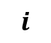
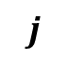
IAC step 1: Compute ${AoA}_{1}$
$$i$$
$$j$$
$$i$$
$$j$$
A
Align ${AoA}_{1}/ΔT_{1}$
Cancel Path 1
-
B
A
A
-
C
A
B
B
-
D
B
C
C
-
E
C
D
D
-
F
D
E
E
-
…
…
…
…
-
Raw Signal
Aligned Signal
Residue
Find ${AoA}_{1}(ΔT_{1})$ that minimizes residue
Notes:
Solving the direct path AoA is easy. This part is same with the conventional AoA algorithm that we just mentioned.With microphone pair (i, j), we find the delta T1 delay between microphones. If we find the correct delay, signals from two microphones will be identical, so we subtract one from another and the residue will be zero.
The delay delta T1 and AoA is an 1-to-1 mapping, so we can estimate the direct path AoA correctly.

Slide 27
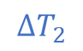
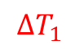
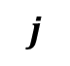
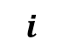

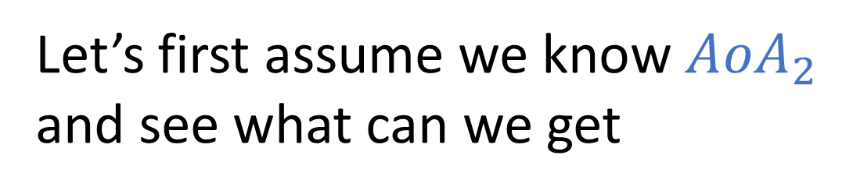
IAC step 2: Compute ${AoA}_{2}$
Let’s first assume we know ${AoA}_{2}$ and see what can we get
$$i$$
$$j$$
A
$$ΔT_{1}$$
B
C
A
D
B
E
C
F
D
$$ΔT_{2}$$
G
E
a
H
a
F
b
I
b
G
c
J
c
H
d
K
d
I
e
L
e
J
f
M
f
K
g
…
…
…
…
Raw Signal
Notes:
After computing the AoA1, Next let’s see how do we compute the AoA of the second path.
This is much harder, because now the microphone recording is the summation of both the direct path, the red signal, and the second path, the blue signal.
Let’s first assume we know the AoA2, and thus we know the delta T2, and what equations are there.

Slide 28









IAC step 2: Compute ${AoA}_{2}$
$$i$$
$$j$$
$$i$$
$$j$$
A
A
A
B
B
-a
$$ΔT_{1}$$
Cancel Path 1
Align ${AoA}_{1}/ΔT_{1}$
C
C
-b
B
D
D
C
A
E
E
a
-c
D
B
F
F
b
$$ΔT_{1}+ΔT_{2}$$
a-d
E
C
G
G
c
b-e
F
D
H
a
H
d
c-f
G
E
a
$$ΔT_{2}$$
d-g
I
b
I
e
…
H
a
F
b
J
c
J
f
I
b
G
c
K
d
K
g
($ΔT_{1}+ΔT_{2}$ differential of source signal)
J
c
H
d
L
e
L
e
K
d
I
e
M
f
M
f
L
e
J
f
…
…
…
…
M
f
K
g
Residue
…
…
…
…
Aligned Signal
Raw Signal
Notes:
In the first step, we align the microphone signal based on the first AoA, or delta T1. In this case, the red signal will be cancelled.
And let’s see what’s the residue? Of course the residue is all from second path, the blue part.
And we can see that now the second path is shifted by delta T1 + delta T2, so after subtract, we’ll get the time domain signal –a, -b, -c, a-d, and so on…, as the residue.

Slide 29





IAC step 2: Compute ${AoA}_{2}$
$$i$$
$$j$$
A
$$ΔT_{1}$$
$$i$$
$$j$$
B
C
A
A
D
B
B
$$ΔT_{1}+ΔT_{2}$$
A
E
C
Cancel Path 2
F
D
C
B
G
E
a
$$ΔT_{2}$$
D
A
C
H
a
F
b
E
B
D-A
I
b
G
c
F
C
E-B
J
c
H
d
G
D
F-C
H
a
E
a
G-D
K
d
I
e
…
L
e
J
f
Align ${AoA}_{2}/ΔT_{2}$
I
b
F
b
M
f
K
g
J
c
G
c
…
…
…
…
K
d
H
d
L
e
I
e
M
f
J
f
($ΔT_{1}+ΔT_{2}$ differential of source signal)
Raw Signal
…
…
…
…
Aligned Signal
Residue
Notes:
On the other hand, if we do not align the signals with delta T1, instead, we align using delta T2 and cancel the blue path.
The residual, of course, will now be the red direct path signals, with the same delta T1 + delta T2 shift.
Here it’s A, B, C, D-A, etc.

Slide 30






IAC step 2: Compute ${AoA}_{2}$
$$i$$
$$j$$
Align and Cancel ${AoA}_{1}/ΔT_{1}$
-a
-b
-c
A
$$ΔT_{1}$$
a-d
B
b-e
-
C
A
c-f
2nd Path’s Shift ($∆t$) & Scale ($α$)
-
D
B
$$∆t$$
d-g
-
E
C
…
-
F
D
-
G
E
a
$$ΔT_{2}$$
A
-
H
a
F
b
B
-
I
b
G
c
C
J
c
H
d
Align and Cancel ${AoA}_{2}/ΔT_{2}$
D-A
Final Residue
K
d
I
e
E-B
L
e
J
f
F-C
M
f
K
g
G-D
…
Find three variables, (1) $AoA_{2}(ΔT_{2})$, (2) 2nd path’s time shift $Δt$, (3) scale $α$, that minimize final cancellation residue
…
…
…
…
($ΔT_{1}+ΔT_{2}$ differential of source signal)
Raw Signal
Residues
Notes:
If we compare these two residuals, we’ll find that these residual array is linear dependent. We can shift the upper blue signal, multiply it with a scaler alpha, and it will become this lower red signal.The scaler is the amplitude ratio of the direct path and the second path.So if we can shift and scale the blue residue, and cancels the red residue vector.We can claim that we find the correct AoA2, or delta T2.This concludes the second step of IAC algorithm: find 3 variables, AoA2, time shift, and scale, that minimize the cancellation residue.

Slide 31



Objective Function is not Convex, but manageable …
Final Residue
2nd path’s scale 𝛼
2nd path’s time shift $Δt$
$${AoA}_{2}/ΔT_{2}$$
But what happens with 3rd, 4th, and K incoming paths?
Notes:
The objective function is not convex, but quite manageable for the 2nd path <br>
But what happens when K>2, 3rd, 4th and more incoming paths

Slide 32




IAC step K: Compute ${AoA}_{k}$
Align and Cancel 1st Path
Align and Cancel 2nd Path
-
Linear Combination
-
-
$$i$$
$$j$$
-
-
-
-
Align and Cancel 3rd Path
Final Residue
Theoretically, residues of all $k$ paths
are linearly dependent (proof in the paper)
Raw Signal
Residues
Notes:
For the next K path, we can find the Kth residue vector, and all the residue vectors will still be linearly dependent.
So theoretically, IAC can find arbitrary number of paths.

Slide 33



IAC Summary: Find optimal ${AoA}_{k}$, $Δt_{k}$, $α_{k}$
Find $AoA_{1}$ : Align and cancel on first few samples
Find $AoA_{k}$: On next few samples after $AoA_{k−1}$, find ${AoA}_{k}$, $Δt_{k}$, $α_{k}$ that minimize the final residue of all $k$ paths.
Over-determined: $N≫k$ samples decided by $3×k$ variables.
Notes:
This slides conclude of the core algorithm. First, we find the first path AoA by align and cancel on the first few samples, where the second path signal has not arrived.
Second, with the AoA0 determined, we find the AoA for next path by solving jointly solving three variables, the new AoA, path delay delta tk, and path scaler alpha k.
The objective function is the final residue vector after aligning all k paths. Note that this problem is over-determined, because we have many samples from different pause opportunities, and only 3 k variables, where k is the number of paths

Slide 34
This paper
1. A new AoA algorithm
2. Application: voice localization
Notes:
With this new AoA algorithm, let’s see how this can be useful in a voice localization application

Slide 35





Alexa,
turn on the light
Notes:
For example, when you say, Alexa, turn on the light. <br>
It should search the places like<br>
bedroom, living room, kitchen, and study room. <br>
And finally it knows: ah, you’re in the kitchen, and turns on only the kitchen’s light

Slide 36



Alexa, add “urgent” to groceries
Do you mean “detergent”?
Notes:
When you’re in the laundry and say, <br>
Alexa, add “urgent” to groceries.
Of course Alexa knows “urgent” is not a product. Because you’re in the laundry, it will try to make a guess: <br>
Oh, do you mean “detergent”?

Slide 37




Can Amazon Alexa localize the user from her voice command
$$θ_{1,2}$$
Require 2 AoAs
Require wall config
Reverse triangulation
$$θ_{1,1}$$
VoLoc Part II: How to find the wall distance/ orientation
Notes:
The target is to tell where is the user when Alexa hears the command. <br> Imagine a house where Alexa is using the microphone array <br> and imagine a user giving a voice command <br> When the user speaks, the voice arrives over the line of sight path … as well as echoes that bounce off the walls. VoLoc wants to use these signals to estimate the user’s location. Observe that VoLoc already knows the 2 AoAs of the signals. <br>However, it’s not enough, we need to know where is the wall <br> and then we can do reverse triangulation to locate the user<br>
But how can we know where is the wall?

Slide 38




VoLoc estimates wall geometry using past voice commands
By assuming one stable wall, models echoes from the wall, and solves a minimization function.
Notes:
To find the wall configuration, we run optimization on all past commands. <br>
We models echoes from the wall, and solves a minimization function
<br> we can see that the wall config converges with in just 10 commands.

Slide 39
Implementation and Evaluation
Notes:
At the end, let’s see the VoLoc implementation and evaluation

Slide 40

Seeed Studio 6-Mic Circular Mic Array + Raspberry Pi
(To obtain raw acoustic samples)
6 Microphones
Raspberry Pi
Notes:
Because native Amazon Echo speaker does not provide raw audio samples, we use a 6 mic circular array hat on a raspberry pi to simulate the smart speaker

Slide 41

Comparison with existing algorithms
VoLoc can improve the AoA estimates of at least 2 echoes
Notes:
Comparing with existing algorithms like GCC-PHAT and MUSIC, VoLoc can improve the AoA estimates of at least 2 echoes, and the improvement on the 2nd AoA is substantial

Slide 42
Overall location accuracy
Median location error: 0.44 meters
Notes:
And our system report the median location error of 44 cm in different environments like studio, kitchen, office.

Slide 43



Location accuracy over clutter level
Notes:
We have also tested the algorithm when the speaker is in a clutter environment, meaning there are many objects creating reflections. The performance is affected, but still stable.

Slide 44


VoLoc Summary
Iterative align and cancel (IAC) algorithm
Indoor user localization from voice signals
Single microphone array (Alexa) as the receiver
Reverse triangulate with few AoAs
Median error < 50cm
Notes:
To sum up,
We propose an IAC algorithm to estimate the AoAs of every echoes
And we propose VoLoc, an indoor user localization system using voice signals as the input.
We need a microphone array like Alexa Echo as the receiver, and we use the direct path and the reflected path to do reverse triangulate to localize the user
We can achieve the median positioning error is less than 50cm

Slide 45






Much more in the paper
Shen
Daguan
Zhijian
Yu-Lin
Romit
Notes:
For technical details and more results, please refer to our paper.

